Slide 1

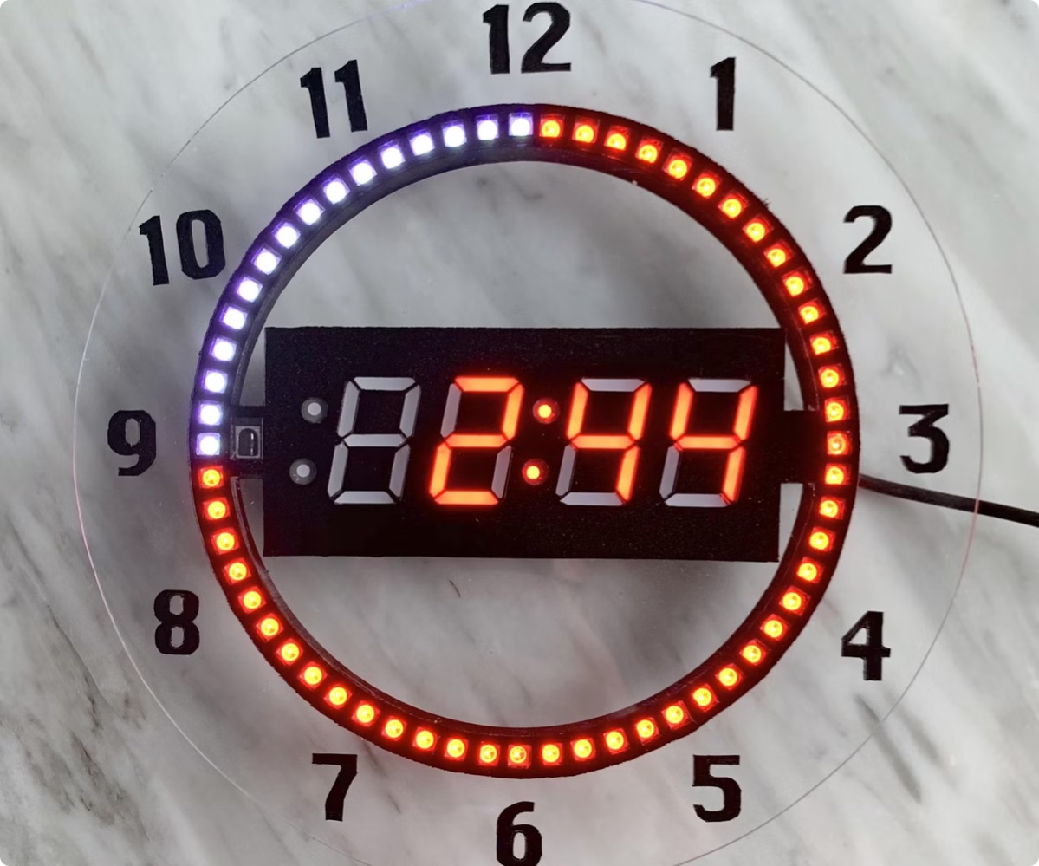
Event Countdown App BY . Flutter
Track important events with ease. Never miss a deadline or special occasion again.
BY:
Mohamed Wael Mohamed Mahdy Rehab shehta Abdallah
Abdalla abdelrhman Mohamed Samaa Hassanin Ismail
Nada Hesham Ibrahim

Slide 2

Tracking event countdowns with ease
1
Organize Your Life
2
Reduce Stress
3
Focus on What Matters
Keep track of birthdays, anniversaries, deadlines, and more.
Stay informed and avoid missed events with timely reminders.
Visualize upcoming events and prioritize your tasks.

Slide 3

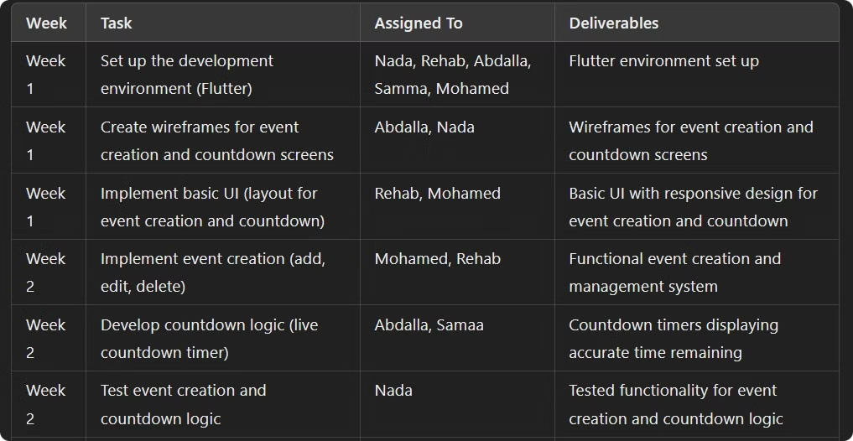
Development timeline: schedule for team member tasks

Slide 4

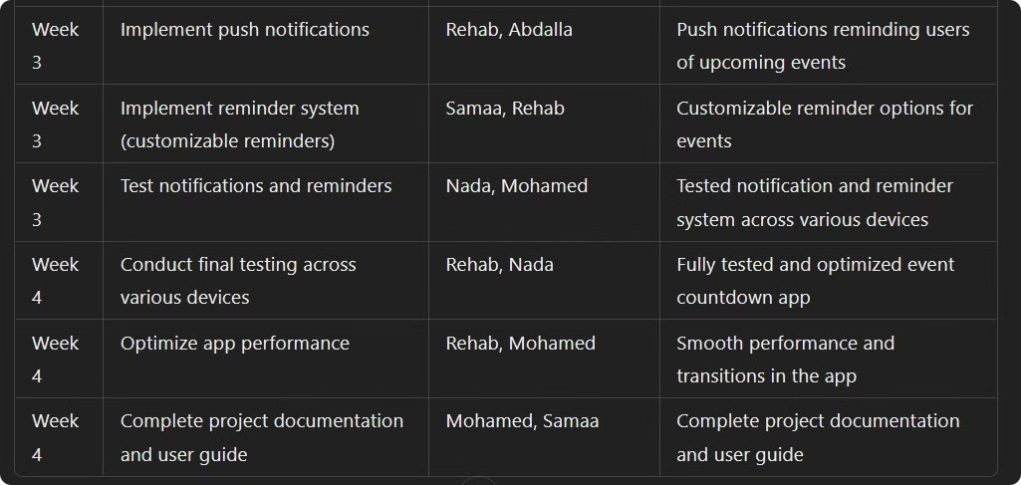
Development timeline: schedule for team member tasks

Slide 5

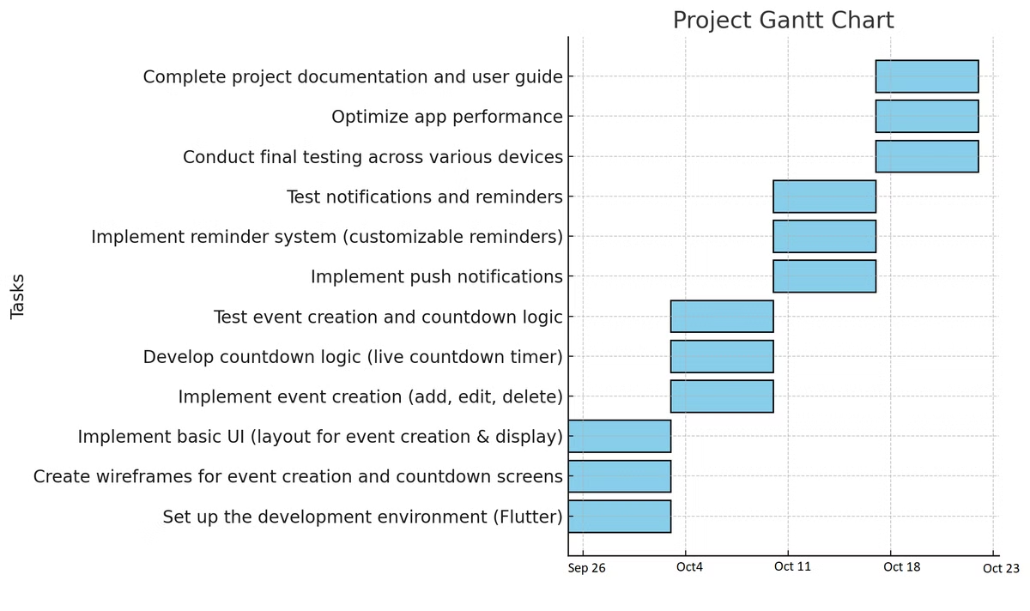
Gannt Chart:

Slide 6

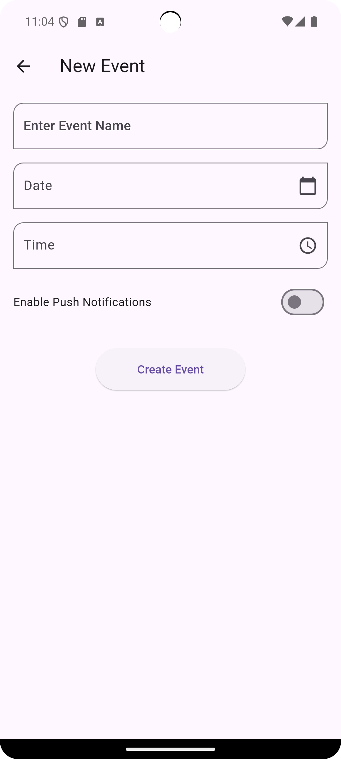
Event creation: Title, date, time, color
Event Title
Date & Time
Give your event a descriptive name for easy identification.
Set the exact date and time of your event for accurate countdown.
Color
Choose a color to personalize your event and make it stand out.

Slide 7

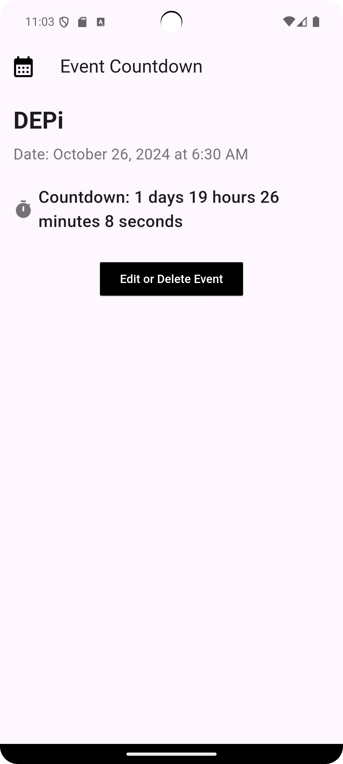



Countdown: Days, hours, minutes
Days
The number of days remaining until the event.
Hours
The number of hours remaining until the event.
Minutes
The number of minutes remaining until the event.

Slide 8

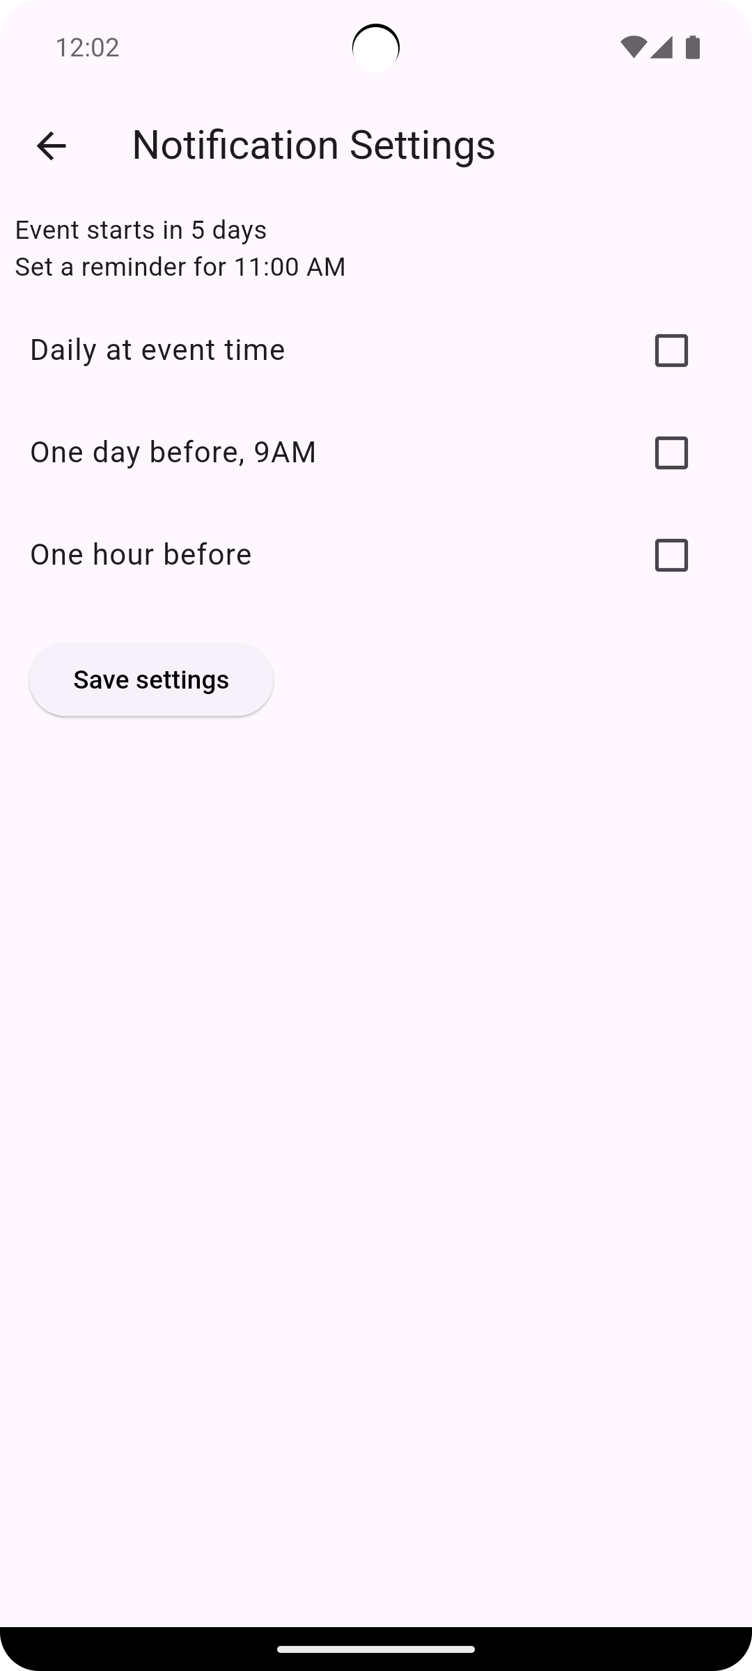
Edit events,data persistence,push Notfication
Edit Events
push Notfication
Data Persistence
Modify event details like title, date, time, and color.
Push notifications reminding users of upcoming events
Save your events even after closing the app, so your data is always accessible.

Slide 9

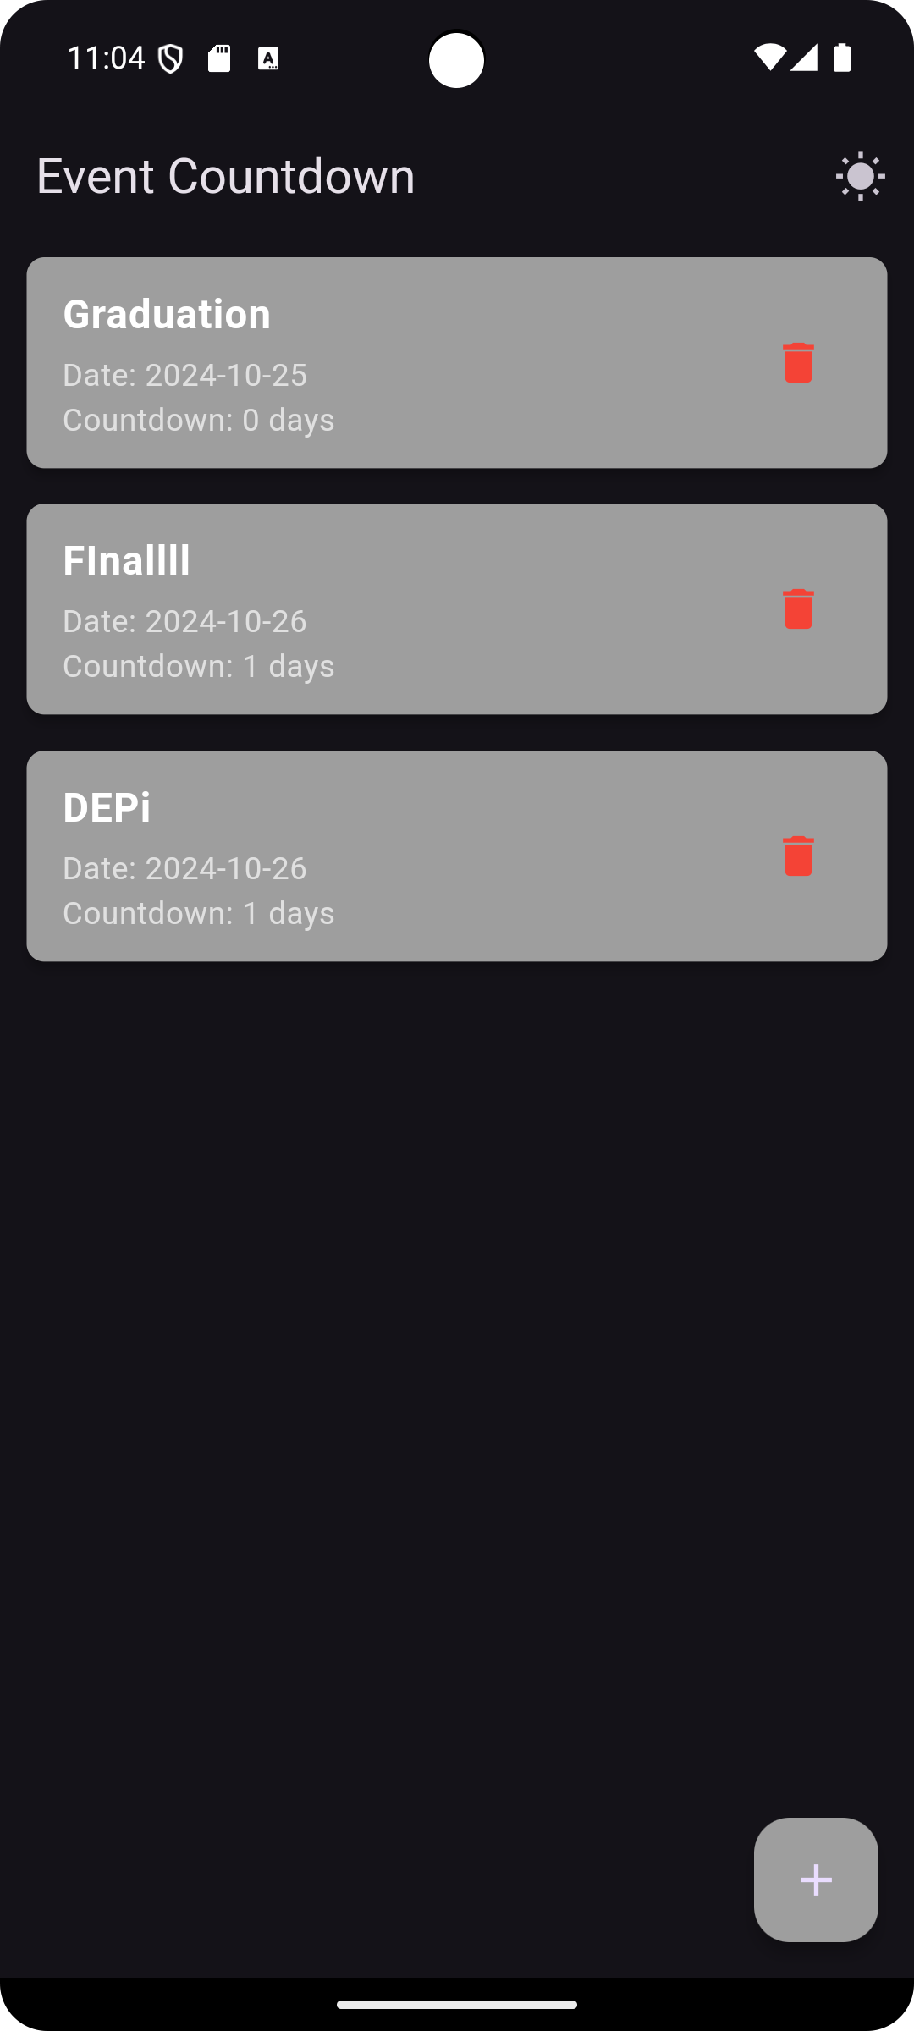
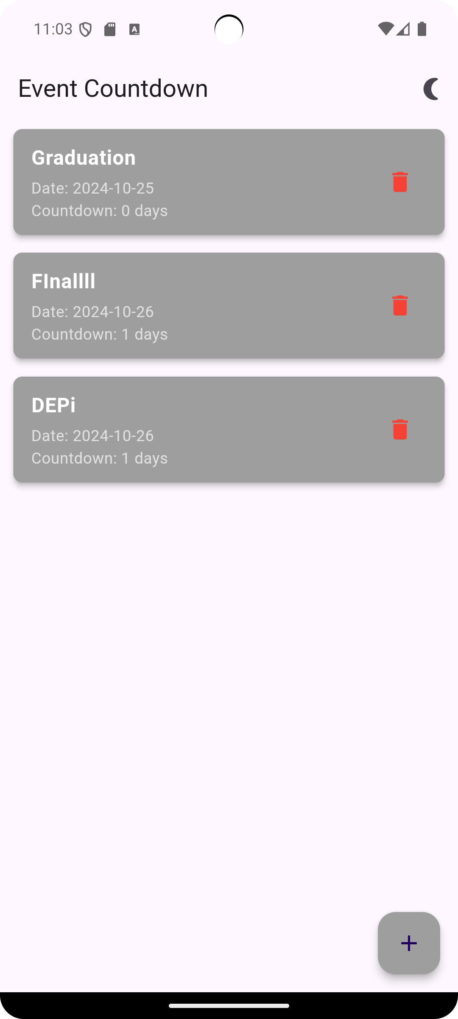



Clean, customizable user interface
Minimalist Design
A clean and uncluttered interface for a streamlined experience.
Customization Options
Choose color themes to personalize your app.
Dark Mode
Reduced Eye Strain,, Improved Battery Life, Less Distraction.

Slide 10

Why this app is useful
Organize Your Events
Reduce Stress
Stay on Top of Deadlines
Improve Time Management
Enhance Productivity
Celebrate Important Occasions

Slide 11
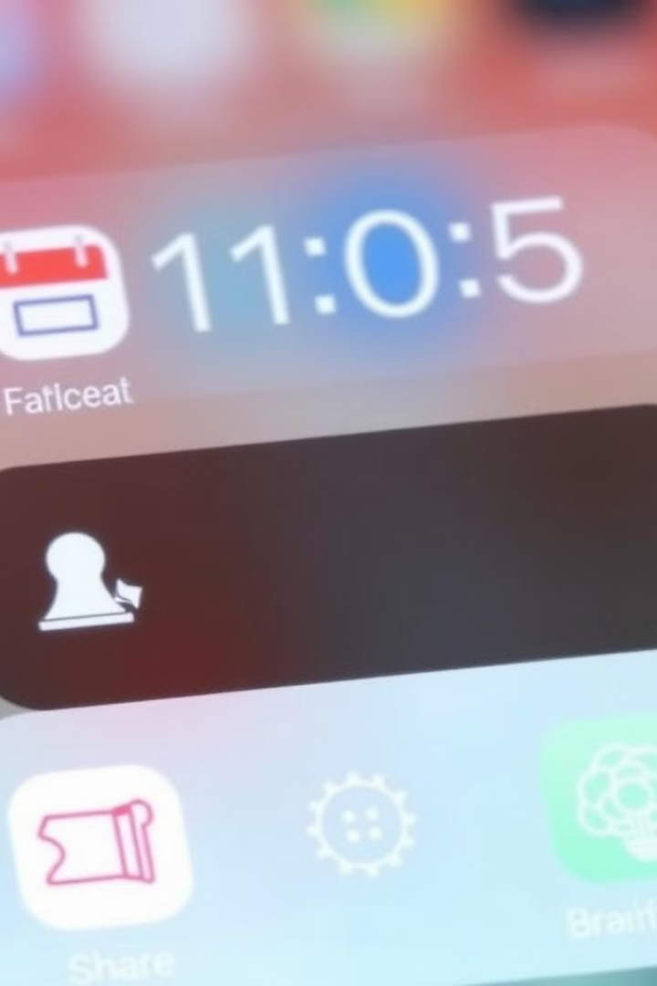
Future Plans
1
Event Sharing
2
Calendar Integration
Allow users to share their event countdowns with friends and family.
Connect with calendar apps to automatically add events and receive reminders.

Slide 12

Thank You
We appreciate your time and interest.
We are excited to bring this app to life.

